Slide 1

AI-Based Personal Finance Manager with Smart Expense Prediction System
by
S. HEMANTH KUMAR
Roll No. 224G1A0528
B. JAHNAV ARJUN GOWD
Roll No. 224G1A0532
T. PAVAN
Roll No. 224G1A0567
Under the guidance of
Mr. P. SHAJAHAN, M.Tech. Assistant Professor
Department of Computer Science and Engineering
Srinivasa Ramanujan Institute of Technology
Autonomous
Rotarypuram Village, B K Samudram Mandal, Ananthapuramu – 515701.
2025-2026
Srinivasa Ramanujan Institute of Technology

Slide 2
Contents
AI-Based Personal Finance Manager with Smart Expense Prediction System
Title Justification
Abstract
Problem statement
Objectives of Project
Literature survey for objectives
Proposed Work - (Methods to be followed for proposed system)
References
GitHub Link
Queries
Srinivasa Ramanujan Institute of Technology

Slide 3
Title Justification
AI-Based Personal Finance Manager with Smart Expense Prediction System
The title “AI-Based Personal Finance Manager with Smart Expense Prediction System” clearly describes the purpose, functionality, and uniqueness of the project.
The term “Personal Finance Manager” indicates that the system is designed to help users manage their financial activities such as income tracking, expense monitoring, budgeting, and savings in an organized manner.
The phrase “AI-Based” highlights the integration of Artificial Intelligence in the system. It emphasizes that the application goes beyond traditional finance management by incorporating machine learning techniques to provide intelligent insights.
The component “Smart Expense Prediction System” represents the key innovation of the project. It signifies that the system can analyze past financial data and predict future expenses using the XGBoost Regression algorithm, enabling users to make informed financial decisions.
Therefore, the title effectively reflects that the project is not just a basic finance tracker, but an intelligent, data-driven system that enhances financial planning through prediction and automation.
Srinivasa Ramanujan Institute of Technology

Slide 4
Abstract
AI-Based Personal Finance Manager with Smart Expense Prediction System
The AI-Based Personal Finance Manager with Smart Expense Prediction System is designed to help users manage their personal finances more effectively. Traditional expense tracking methods mainly record past transactions and provide limited support for financial planning. To overcome this limitation, the proposed system provides a web-based platform where users can track daily expenses, manage budgets, and monitor savings goals.
The system analyzes historical spending data and predicts future expenses using the XGBoost Regression algorithm. It also provides expense analysis, spending insights, and budget alerts to help users understand their financial behavior and avoid overspending. The proposed system improves financial planning, supports better budgeting decisions, and promotes smarter money management through intelligent expense prediction.
Srinivasa Ramanujan Institute of Technology

Slide 5
Problem Statement
AI-Based Personal Finance Manager with Smart Expense Prediction System
Traditional personal finance management methods mainly focus on recording past expenses and require users to manually track their financial activities. Existing expense tracking systems provide limited support for analyzing spending behavior and do not offer intelligent prediction of future expenses. Without proactive financial insights and automated budget monitoring, users often experience overspending, poor savings management, and difficulty in long-term financial planning. In addition, the absence of smart alerts and spending analysis makes it challenging for users to identify unusual financial patterns and maintain effective control over their personal finances.
Srinivasa Ramanujan Institute of Technology

Slide 6
Objectives of Project
AI-Based Personal Finance Manager with Smart Expense Prediction System
OBJECTIVE 1
To develop an AI-Based Personal Finance Manager that enables users to record, organize, and manage daily expenses, monitor category-wise budgets, and track savings goals through a centralized web-based platform for efficient financial management.
OBJECTIVE 2
To design and implement machine learning models that analyze historical spending patterns, predict future expenses, generate budget alerts, and support users in improving financial planning and spending control.
Srinivasa Ramanujan Institute of Technology

Slide 7
AI-Based Personal Finance Manager with Smart Expense Prediction System
Literature survey for objectives
No | Title | Author | Year | Methodology Adapted | Key Findings | Gaps
1. | AI-Powered Personal Finance Management: Predictive Analytics for Expense Forecasting | Sharma& Patel | 2023 | Machine learning models for expense prediction using financial data analysis | Predicts monthly expenses with high accuracy using historical spending patterns | Does not include full expense management and budgeting features
2 | Intelligent Budget Optimization Using Machine Learning Algorithms | Chen, L., & Williams, R. | 2022 | Machine learning techniques for dynamic budget optimization | Improves budget planning by analyzing user spending behavior | Limited focus on user-friendly personal finance tracking
3 | NLP-Based Automated Expense Categorization in Financial Applications | Rodriguez, M., & Kim, J. | 2021 | Natural Language Processing for automatic transaction categorization | Automatically categorizes expenses and improves financial data organization | Does not provide expense prediction
Srinivasa Ramanujan Institute of Technology

Slide 8
Proposed System
AI-Based Personal Finance Manager with Smart Expense Prediction System
Our project presents an AI-Based Personal Finance Manager with Smart Expense Prediction System that integrates intelligent financial management features within a centralized web-based platform. The system consists of the following major modules:
Expense Management Module: Allows users to record, update, and manage daily financial transactions by organizing expenses into categories such as food, travel, shopping, utilities, and entertainment for systematic financial tracking.
Budget and Savings Management Module: Enables users to define monthly budgets and savings goals, continuously monitor spending behavior, and receive notifications when expenses approach predefined budget limits.
Smart Expense Prediction Module: Uses the XGBoost Regression algorithm to analyze past spending patterns and predict future expenses for better financial planning.
Dashboard and Reporting Module: Provides graphical reports, spending summaries, category-wise expense analysis, and prediction results through an interactive dashboard that helps users understand their financial behavior effectively.
Srinivasa Ramanujan Institute of Technology

Slide 9
References
AI-Based Personal Finance Manager with Smart Expense Prediction System
L. Chen and H. Zhao, “Machine Learning Applications in Personal Finance: A Systematic Review,” Journal of Financial Technology, vol. 12, no. 3, pp. 45-67, 2023.
R. Patel and S. Kumar, “AI-Driven Expense Prediction Using Time Series Analysis,” International Conference on Artificial Intelligence in Finance, vol. 1, pp. 112-118, 2022.
P. Gupta and M. Lee, “Behavioral Analytics in Personal Finance Management Systems,” Journal of Behavioral Finance, vol. 19, no. 4, pp. 301-317, 2022.
D. Wilson and X. Chen, “Django Framework for Scalable Financial Web Applications,” Software: Practice and Experience, vol. 52, no. 9, pp. 1876-1895, 2022.
Srinivasa Ramanujan Institute of Technology

Slide 10
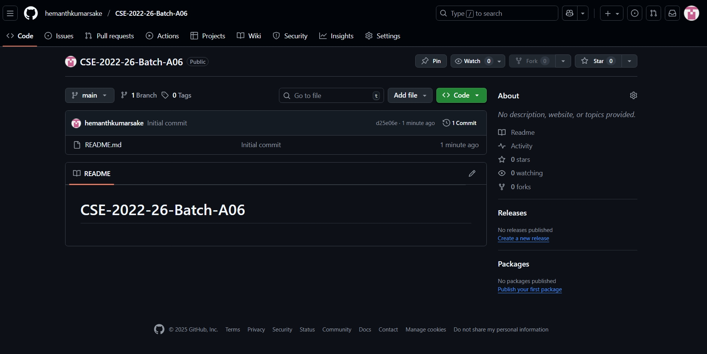
Git Hub Dashboards of each student
AI-Based Personal Finance Manager with Smart Expense Prediction System
Github Link : https://github.com/hemanthkumarsake/CSE-2022-26-Batch-A06
Srinivasa Ramanujan Institute of Technology

Slide 11
Any Queries?
AI-Based Personal Finance Manager with Smart Expense Prediction System
Srinivasa Ramanujan Institute of Technology

Slide 12
Thank You!!!
AI-Based Personal Finance Manager with Smart Expense Prediction System
Srinivasa Ramanujan Institute of Technology

